Slide 1
INTRODUCTION TO DATABRICKS

Slide 2

Learning objectives
Introduction to Databricks
Key Features and Benefits of Databricks
Databricks Architecture
Databricks for Data Engineering
Platform Walkthrough

Slide 3
DATABRICKS – INTRODUCTION
Databricks is an enterprise software created by the creators of Apache Spark. It revolutionizes data management and analytics through advanced Data Engineering tools designed for processing and transforming large datasets to build machine learning models.
Databricks is built on top of distributed Cloud computing environments (Azure, AWS, or Google Cloud) and fosters innovation and development, providing a unified platform for all data needs, including storage, analysis, and visualization.

Slide 4
DATABRICKS – KEY FEATURES
Language: Databricks leverages spark to support multiple coding languages in the same environment. Using magic commands (%python, %r, %scala, and %sql), a developer can build algorithms using Python, R, Scala, or SQL. For instance, data transformation tasks can be performed using Spark SQL, model predictions made by Scala, model performance can be evaluated using Python, and data visualized using R.

Slide 5
DATABRICKS – KEY FEATURES
Productivity: It increases productivity by allowing users to deploy notebooks into production instantly. Databricks provides a collaborative environment with a common workspace for data scientists, engineers, and business analysts. Collaboration not only brings innovative ideas but also allows others to introduce frequent changes while expediting development processes simultaneously. Databricks manages the recent changes with a built-in version control tool that reduces the effort of finding recent changes.

Slide 6
DATABRICKS – KEY FEATURES
Flexibility: It is built on top of Apache Spark that is specifically optimized for Cloud environments. Databricks provides scalable Spark jobs in the data science domain. It is flexible for small-scale jobs like development or testing as well as running large-scale jobs like Big Data processing. If a cluster is idle for a specified amount of time (not-in-use), it shuts down the cluster to remain highly available.

Slide 7
DATABRICKS – KEY FEATURES
Data Source: It connects with many data sources to perform limitless Big Data Analytics. Databricks not only connects with Cloud storage services provided by AWS, Azure, or Google Cloud but also connects to on-premise SQL servers, CSV, and JSON. The platform also extends connectivity to MongoDB, Avro files, and many other files.

Slide 8
DATABRICKS – KEY COMPONENTS
In Databricks environments, there are 4 major components
Workspace
Notebooks
Cluster
Metastore

Slide 9
DATABRICKS – KEY COMPONENTS
Workspace: An Interactive Analytics platform that enables Data Engineers, Data Scientists, and Businesses to collaborate and work closely on notebooks, experiments, models, data, libraries, and jobs. Here, you can create notebooks, jobs, clusters, and manage access. You can create multiple workspaces for your teams.
Notebooks: Web-based interfaces where you can write code in Python, Scala, or R, execute it, check its results, and visualize it.

Slide 10
DATABRICKS – KEY COMPONENTS
Cluster: Your compute resources and configuration on which you can run your notebooks and jobs. You can create different types of clusters depending on your needs, selecting a version of Databricks runtime, memory, CPU for driver and nodes, etc. Monitor your code and job executions. This is also where you can install the libraries required by your code.

Slide 11
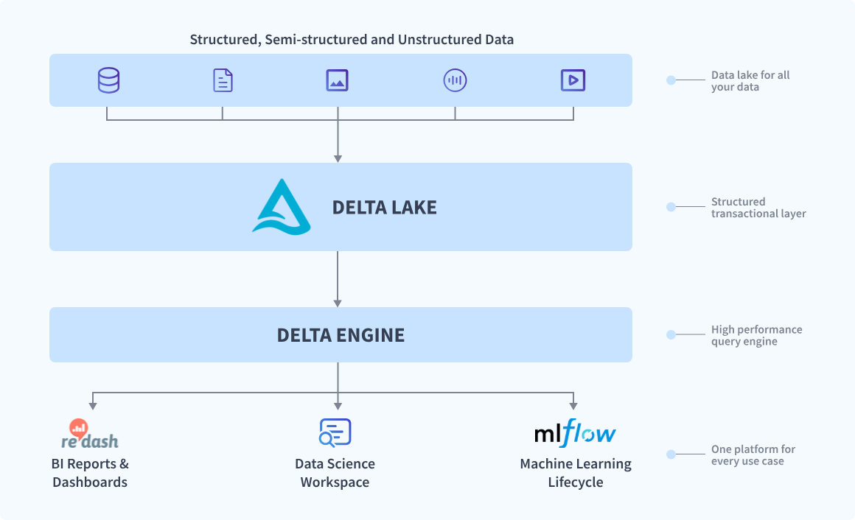
DATABRICKS ARCHITECTURE

Slide 12
DATABRICKS – ARCHITECTURE
Databricks architecture is the application of the Data Lakehouse concept in a unified cloud-based platform. The layers in the databricks architecture are Delta Lake, Delta Engine and inbuilt data science, BI reporting and MLOps tools.
All these components are integrated as one and can be accessed from a single ‘Workspace’ user interface (UI). This UI can also be hosted on the cloud of your choice.

Slide 13
WHY IS DATABRICKS A BIG DEAL?
Databricks provides a unified and wholesome platform with a wide range of capabilities. Some key benefits that make is stand out includes:
‍Cloud-native: Works fine on any prominent cloud provider
Data storage: Stores a broad range of data including structured, unstructured, and streaming
Governance and management: In-built security controls and governance
Data science tools: Production-ready data tooling from engineering to BI, AI, and ML

Slide 14
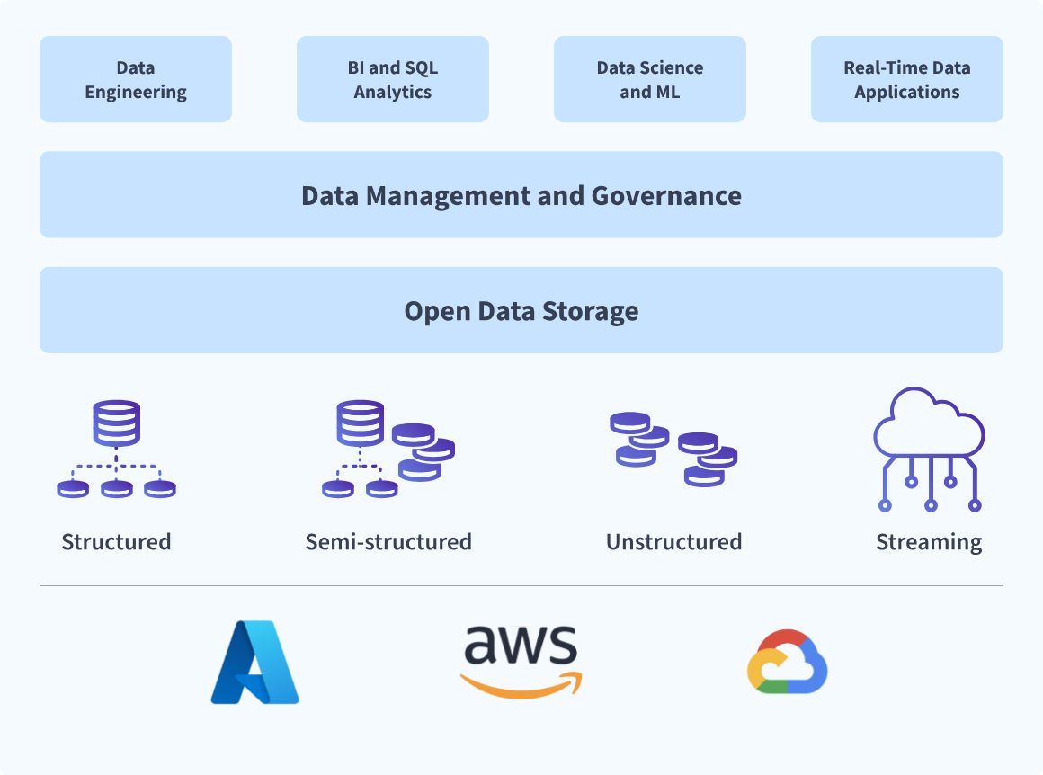
WHY IS DATABRICKS A BIG DEAL?

Slide 15
DATABRICKS FOR DATA ENGINEERING
ETL Workflows: Use Spark SQL for querying data. Transform raw data into refined formats.
Data Pipelines: Automated jobs with Databricks workflows. Orchestration with external tools like Airflow or ADF.
Delta Lake: Handle data versioning and schema evolution. Enable ACID transactions for data integrity.

Slide 16
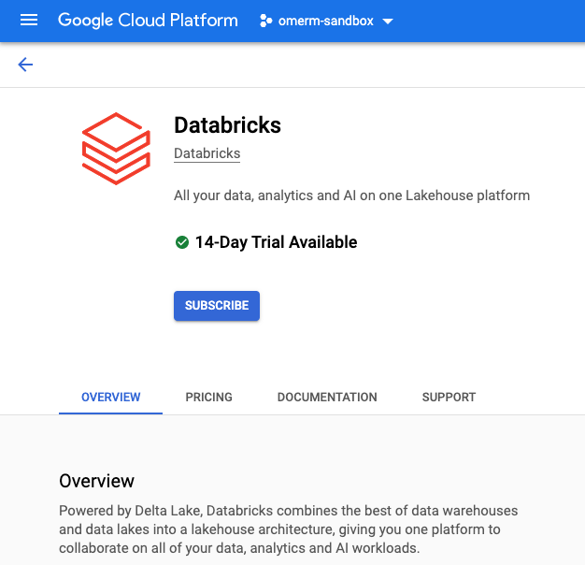
DATABRICKS – PLATFORM WALKTHROUGH
Step 1: Search for Databricks in your cloud provider marketplace, or alternatively, search for databricks community edition (free limited edition). Complete the subscription, or sign up.

Slide 17
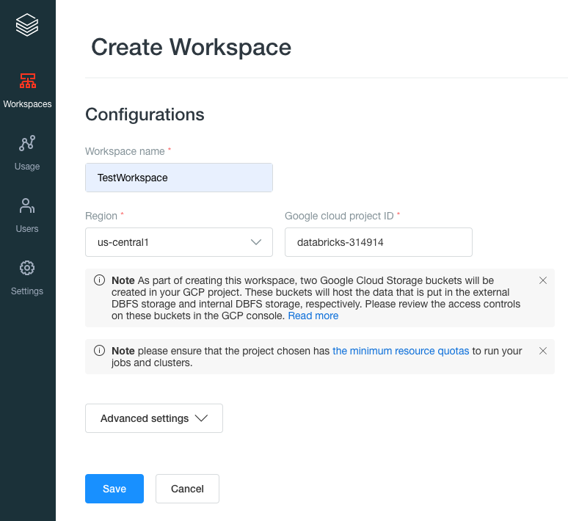
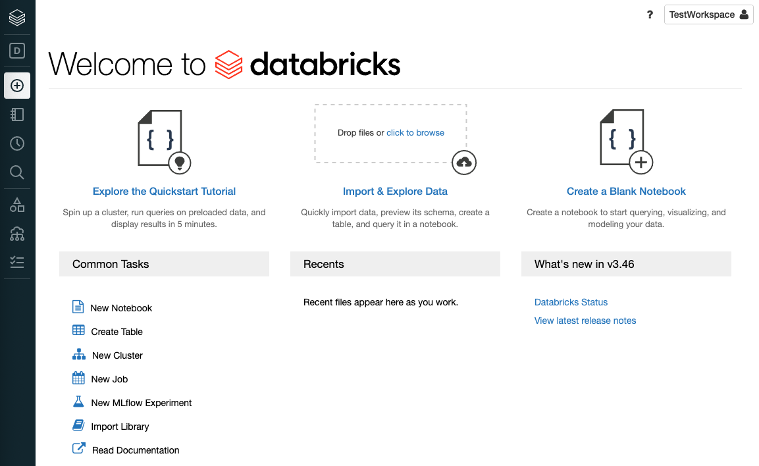
DATABRICKS – PLATFORM WALKTHROUGH
Step 2: Launch your databricks and create a Workspace which is the environment in Databricks to access your assets.

Slide 18
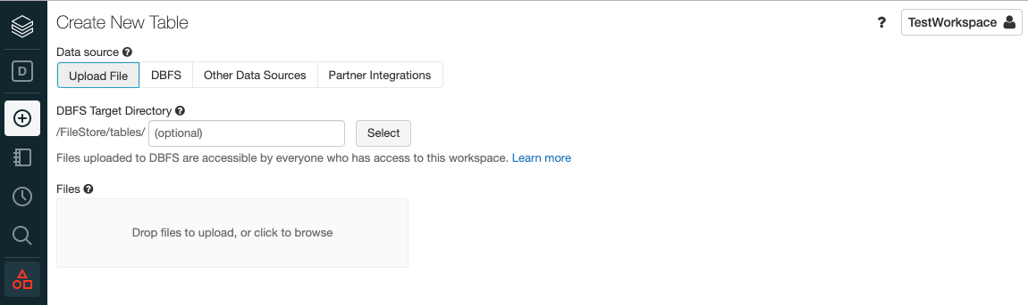
DATABRICKS – PLATFORM WALKTHROUGH
Step 3: Create a table in the Delta Lake, you can either upload a file, or connect to supported data sources

Slide 19
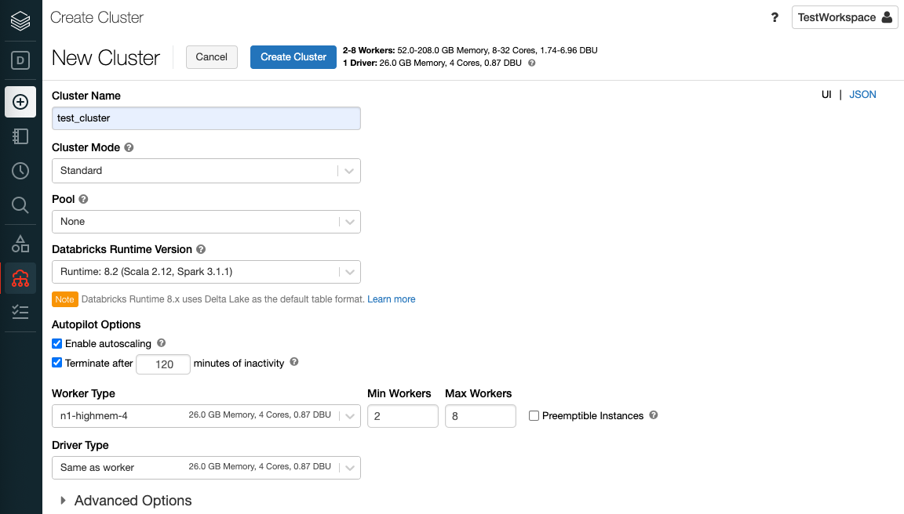
DATABRICKS – PLATFORM WALKTHROUGH
Step 4: Create a Cluster. A Databricks Cluster is a combination of computation resources and configurations on which you can run jobs and notebooks.

Slide 20
DATABRICKS – PLATFORM WALKTHROUGH
Step 5: Create a notebook. In the notebook, you can leverage apache spark to perform a wide range of data transformations, analysis, machine learning or visualization on the data stored in the delta lake.

